Slide 1
Top 5 Technologies
Guided by Mohammad Tahir Mirji
Presented by Priyanka .S.B

Slide 2
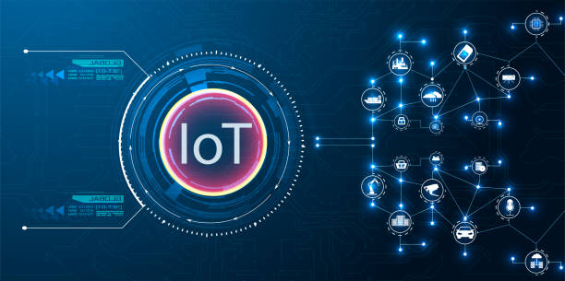
IOT Technology
Definition : The Internet of Things (IoT) describes the network of physical objects—“things”—that are embedded with sensors, software, and other technologies for the purpose of connecting and exchanging data with other devices and systems over the internet.
Benefits of IOT
Saves the time
Minimize the human effort
Improve security
Impact on Business / Industry
Agriculuture
Banking
Health care

Slide 3
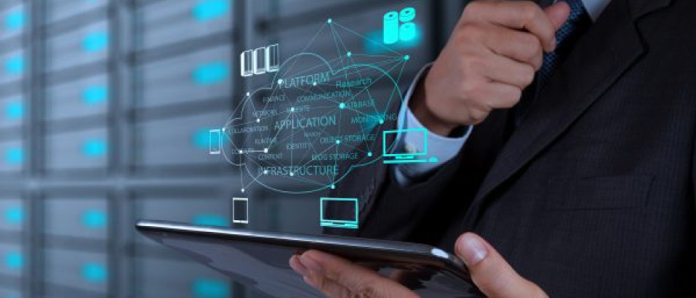
Cloud computing
Definition : It is a delivery of on-demand computing resources as a services over the internet on pay for use basis. Cloud computing refers to a data & applications being stored & run on the cloud rather than your local computer
Benefits of cloud computing
Back up & Recovery
Accessibility
Cost saving
Impact on Business/Industry
Education
Manufacturing
Retail

Slide 4

Chat GPT
Definition : Chat GPT is a powerful tool for businesses looking to improve customer experiences, increase user satisfaction, and create content for search engine optimization.
Benefits :
Time-Saving
Great for Learning
Improve Content Quality
Impact on Business/industry
Banking
Email
Ecommerce

Slide 5
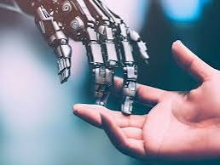
Artificial Inteligence
Definition : using computers to do things that traditionally require human intelligence. AI can process large amounts of data in ways that humans cannot.
Benefits :
Available 24 * 7
Faster Decision
New Invention
Impact on Business/Industry
Health care industry
Self driving cars
Finance

Slide 6
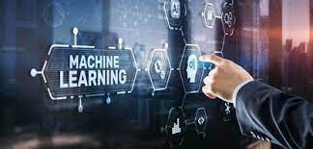
Machine Learning
Definition : Machine learning (ML) is a type of artificial intelligence (AI) that enables you to predict results accurately, even if your application software is not explicitly programmed.
Benefits:
Natural language processing
Speech recognition
Better products
Impact on Business/Industry
Healthcare advancement.
Retail industry
Education.

Slide 7
Thank you

